Slide 1
Climate change, the Environment & Just Transition
Education Department
Environmental Taskforce Film & RISC Presentation
Barry Faulkner (Unite National Political Education Coordinator)
Notes:
Extend thanks to NISC for opportunity to deliver short presentation on behalf of Unite Environment Taskforce (UET).
If the Zoom technology allows, intention is to show a new short film we have just produced entitled ‘Climate Change = Workplace Change’ we’ve developed this as a learning resource, to help raise awareness of the issues and to support Unite’s activities in the run-up to COP26 in Glasgow (November 2021).
After the film, briefly run through PowerPoint slides and allow time for Q&A/conversation session.
(Depending on time allowed, it may not be possible to cover every slide. so focus on just a selection. Where possible, locate a few sector examples to highlight company activity & FTO/Reps and sector experiences.
Following presentation signpost any UET enquiries to Jim Mowatt.

Slide 2
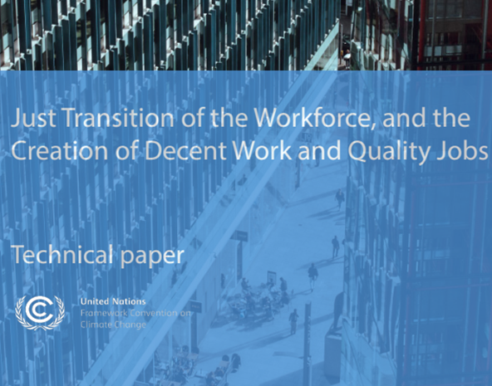
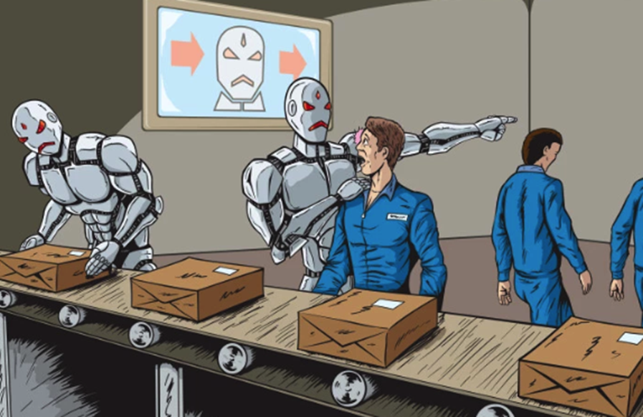
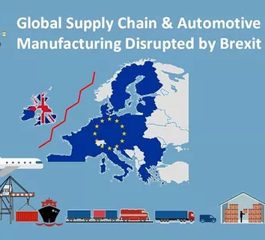
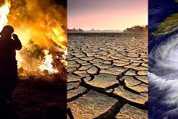
Convergence of… - Brexit - Climate change - Covid -19 - AI & Digital… Some employers will never waste a good crisis!
Building Workers' Power
Workers ‘voice’ & Human Rights
Social provision & protection.
Global Shifts - Just Transitions.
Equality (No one left behind)
Education, Learning, Training & Skills
Notes:
We are at a challenging intersection of events which have converged to present a variety of challenges: industrially; politically; socially; and environmentally.
Global transition towards low-carbon/sustainable economies have both positive and negative impacts on employment, our sectors and regions. In ensuring that workers voices are heard at every level Unite will actively lobby government; network with external agencies; engage employers and apply leverage where necessary.
Transition challenges cant be ignored whilst at the same time delaying the transition is not an option.
Unless urgent mitigation/adaptation measures are taken, climate disruptions will cause significant job losses and tougher working conditions and Unite has to prepare to tackle these developments.

Slide 3
Change is the only constant – and there’s a lot of change going on…
Just Transition across the equality spectrum
From Climate Change to Climate Emergency
Concept of ‘Just Transition’
Green Economic Programmes - World Bank/EU/UK Government’s: 10 Point Plan for a Green Industrial Revolution
Unite: Company/sector initiatives; Freeports, supply-chains, Local Authorities
Sincere initiatives /‘greenwashing’?
Internal & external factors
What’s happening/how can we best support our reps & members?
Notes:
Climate change impacts not just on our environment/natural world but also, increasingly, on our workplaces, communities & wider society. Its influence is being felt at the intersections of global industrial, political, social and economic activities. Combined with the affects of Covid-19 and the use of AI/digital technologies we face a number of challenges in tomorrow’s world of work and beyond.
In addition, the composition of Unite with its 19 industrial Sectors; 4 Equalities Sectors, 10 regions spanning at least 6 jurisdictions means there may inevitably be frictions, even disagreements about our policies and how we respond to these challenges. But in facing these challenges we are stronger together.
The UNITED NATIONS Climate Change Conference COP26, presents an immediate focus on all issues environmental - these are many, varied – sometimes even contradictory. Its important we capture experience across both the public and private sectors. Unite’s education offer will develop Rep/Officers knowledge and skills to ensure informed decisions direct our approach and response. Hence our brief input here today.

Slide 4
Climate change, the Environment & Just Transition
Unite Environment Taskforce (U.E.T.) established
Representatives from research, sectors, education, officers/external partners
Forum to capture & disseminate information
Immediate ambition: - Raise membership awareness of c/change issues & impact on workplaces, sectors, communities & regions - Develop ‘just transition’ strategies & knowledge - Draft Environment Charter in time for TUC & Labour Party Conferences - United Nations Conference on Climate Change (COP26), Glasgow (Nov’21)
Support internal capacity building/‘best practice’ & external networking
Hold National Conference 16th September (9:30-12:00 hours)
Notes:
Briefly, outline developments and initiatives being progressed by the Education Department/UET
This is a ‘work in progress’ and endeavours to accommodate an immense volume of complex information being produced both internally and externally.
We have adopted a ‘whole union approach’ as, for some sectors, there are immense opportunities whilst other are more vulnerable to the impacts of climate change and transition to a low-carbon economy.
There are inherent linkages between actions and events in one sector and impacts on others. Irrespective of the sector we have to develop strategies and initiatives to engage employers, government and the wider public to ensure no one gets left behind.
Equality, inclusion and ‘building back fairer’ are essential components underpinning our approach.

Slide 5
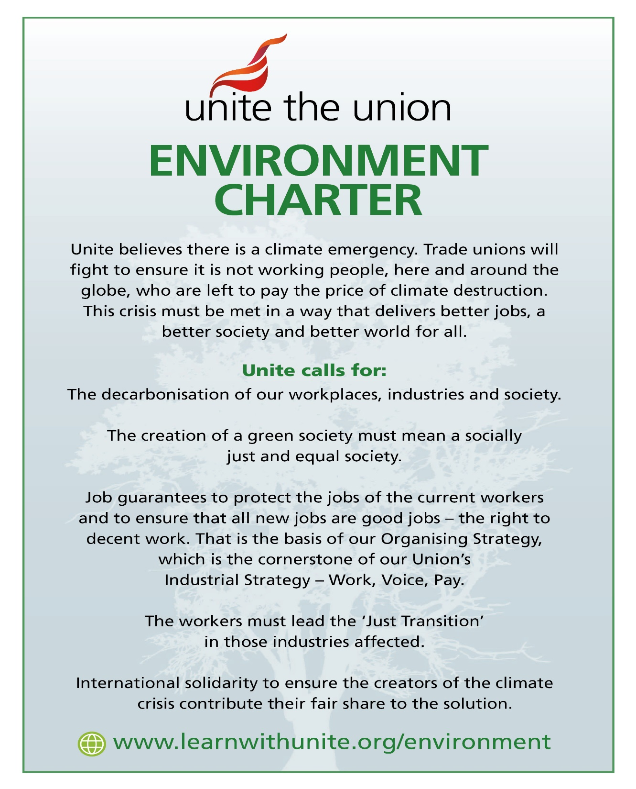
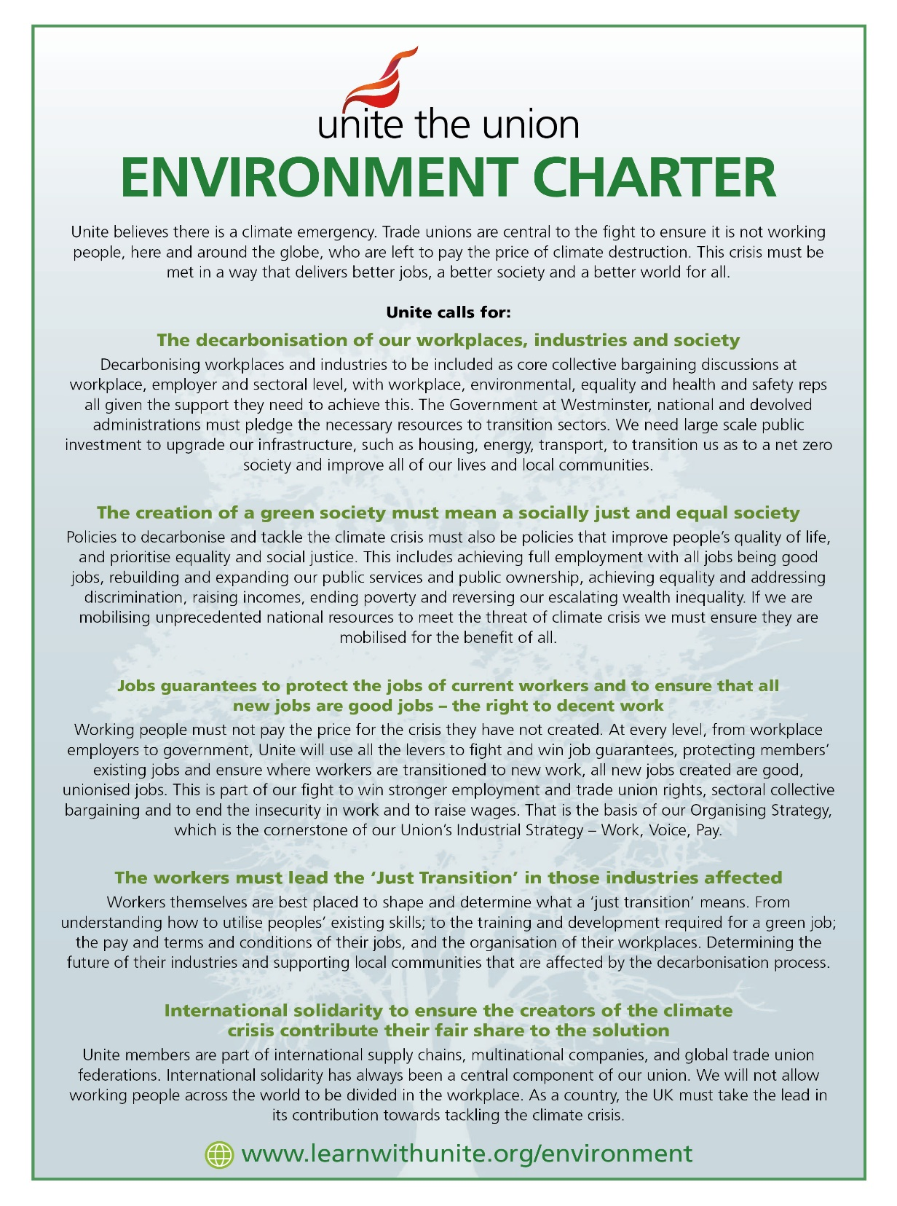

Slide 7
Covid-19 reset: Worker-centred Just Transition Key Concepts and Principles
“A just transition for all towards an environmentally sustainable economy … needs to be well managed and contribute to the goals of decent work for all, social inclusion and the eradication of poverty.” (International Labour Organization)
“Job losses are not an automatic consequence of climate policies, but the consequence of a lack of investment, social policies and anticipation.” Rosemberg (2010)
What Do We Mean By Just Transition? “Just Transition is a principle, a process and a practice.” (Just Transition Alliance)
Notes:
JT is the exact opposite of what happened to the mining industry and mining communities and we have to avoid our repeating that experience in the future by developing a ‘worker-centred just transition’.
Automation and mechanisation of construction, manufacturing, transport and our supply chains continues unabated .
Platform, gig & online business models (e-commerce), digitisation and the use of algorithms impact on work and production processes and with the convergence of Brexit, CV-19 and climate change we have a ‘perfect storm’ challenge ahead of us.
We have faced similar challenges in the past and we need to be confident in our ability, solidarity and the power of our members and union to re-engineer the world of work and take advantage of the opportunities presented.
Members need Unite’s support and leadership more than ever, so we have to get to work and ensure we protect, promote and win for our class!

Slide 8
Developing our ‘Blue Green Print’
Unite Climate Change Taskforce Film (+ sequels/social media roll-out)
https://www.learnwithunite.org/environment/
Awareness raising & Comms’ strategy: - Presentations ‘Hubs’, Equality, RISC’s/NISC’s, & Regional Committees - Unite Environmental Quarterly Report published (J. Mowatt) - Courses: 90-minute, 1-Day, 3-Day & 5-Day online & ‘hybrid’ pathways - Reps Stage A&B courses activities & joint-union-employer training
Linking learning, organising, collective bargaining, industrial, community, E&D & political work
Public & Private sector / Procurement & Tendering / Energy / Waste
Notes:
Strategies and delivery around education, training and skills are essential tools in our approach and the education offer is being expanded to meet the needs of our reps and officers.
Courses and activities have been designed, trialled and are starting to be rolled out in the near future. For the moment, these will be online but we will deliver ‘hybrid’ courses both on and offline when we are able to return to the classroom.
Members, reps and officers will be able to access resources being made available via the ‘Environment Page’ on the learnwithunite website @ https://www.learnwithunite.org/environment/
Across both the public and private sectors, there are many core themes common to all sectors (e.g.; the role of procurement & tendering; the use of energy; the generation and disposal of waste, apprenticeship training etc). But there are also distinct difference and we will endeavour to develop generic and bespoke materials as we progress our training offer.

Slide 9
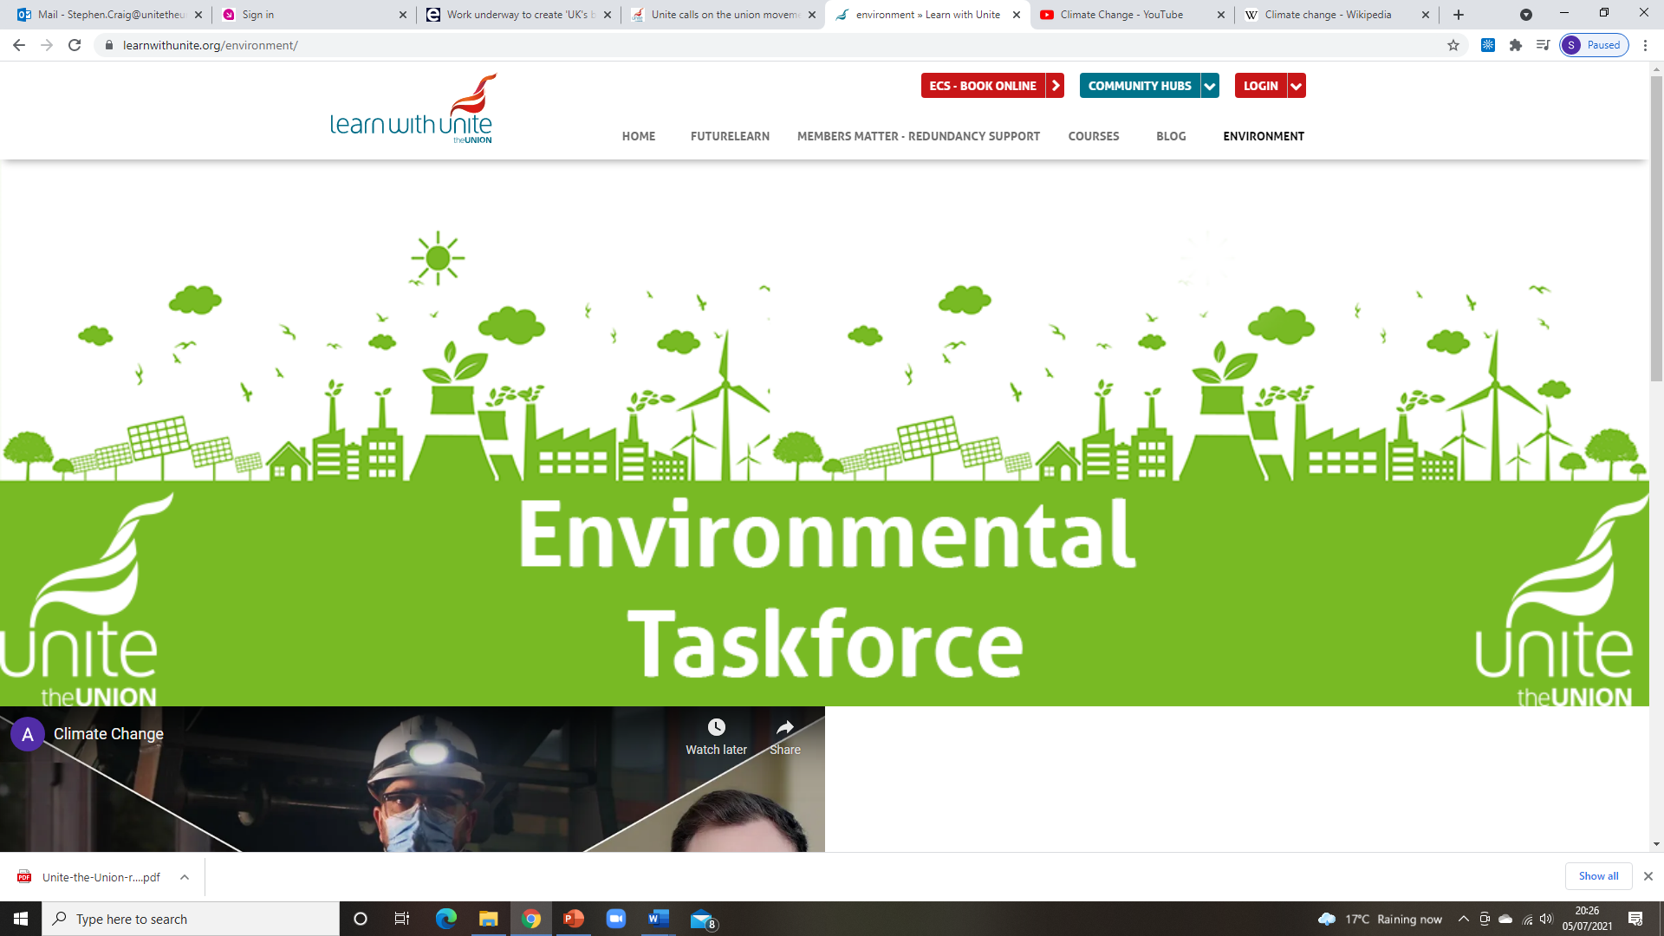
https://www.learnwithunite.org/
https://www.learnwithunite.org/environment/
Notes:
Example of the learnwithunite Environment page. Platform hosts the UET film and dropdown menus allows access to a wide range of information, advice and guidance.
This site and resources will be developed and expanded on an ongoing basis.

Slide 10
Unite Chemicals Pharmaceuticals Process & Textiles Trade Group
Examples of sector activities…
Notes:
Just by way of brief example, highlight how some sectors are responding to climate change challenges – others are not as advanced in their experience or response. The CPPT sector is hugely diverse. Of the eight industrial sectors that emit two thirds of industrial carbon emissions, four are in CPPT – ceramics, chemicals, glass, and oil refining.
Research conducted by Unite found that there had been little progress around just transition in most of the subsectors, despite the rapid change of direction of many companies (e.g. oil majors rebranding to become energy companies).
This meant that it was important to consider how to develop a unified climate/just transition strategy within the sector.

Slide 11
The Story of Stuff – the ‘materials economy’ https://www.youtube.com/watch?v=9GorqroigqM
Us
Extraction Production Distribution Consumption Waste (Resources)
Example of adaptation intervention: The construction sector is the largest user of materials in the UK and produces the biggest waste stream in terms of tonnage.
At every stage of the construction process there are different opportunities for different professions in construction to reduce waste, and reuse or recycle products, components and buildings, and for materials to move up the waste hierarchy so that ultimately material resources can continue to flow around a circular economy.
Notes:
Although a few years old and this American film gives a useful overview of the role of companies, governments, consumers and other actors in the ‘materials economy’ cycle.
This is just one example of the plethora of online resources available to help raise awareness and inform our understanding of the impact of climate change at all levels of society.

Slide 12
People & planet before profit principles…
https://youtu.be/PY6xzwLXpjg
https://www.learnwithunite.org/
Notes:
Unite wants a ‘seat at the table’ or workers will be on the menu!
‘Worker voice’ @ all levels of the transition to the green economy
Nothing about us without us!
We’ll be accountable to our children – we can’t trust companies with our children’s inheritance!
We have to learn, unlearn, re-learn. Education, learning, training & skills strategies essential.
Organising, representation & collective bargaining for decent work within context of climate change and just transition.
Necessary to align Industrial, political & public policy/actions.
Need you & your sector to get involved if your not already...

Slide 13
THANK YOU
Watch this space!
Notes:
Q&A/Discussion

Slide 14
Unite Environment Taskforce Film ‘Climate change = workplace change’
Cut & paste into your browser or Press Cntrl + click to follow link https://youtu.be/cEGqOZMhQGg

